Slide 1
#DigiInventors Challenge
Primary School Edition
2026 in partnership with
Notes:
Intro slide: Let pupils know that they will be taking part in the #DigiInventors Challenge 2026 and that this challenge is in partnership with Digital Health & Care Innovation Centre (DHI) , City of Glasgow College and RAiSE (Raising Aspirations in Science and STEM Education)- a programme of the Wood Foundation, Education Scotland, Scottish Government, Young STEM Leader Programme, and participating local authorities.
SETUP:
- The following set of slides, includes pick up and play units of work, along with teachers notes and breaks the #DigiInventors Challenge into smaller tasks that will all feed into elements needed for an individual, pair or team entry.

Slide 2

Who are the Digital Health & Care Innovation Centre?
Notes:
Let’s begin by looking at a short introduction to the Digital Health & Care Innovation Centre, based in Glasgow, and what they do.
Link for video: https://vimeo.com/646090443
Video length: 4min 07seconds

Slide 3
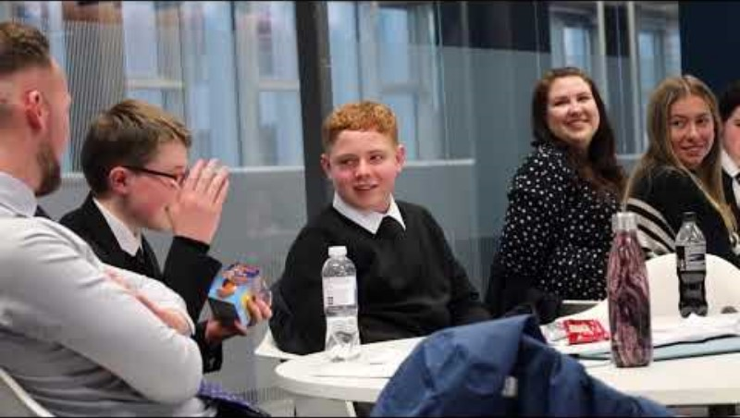
What is the #DigiInventors Challenge 2026
Notes:
TOPIC - Digital Health Tech #DigiInventors Challenge
Working through this challenge, we want to raise awareness of the digital health technology sector and would like the young people to identify and create a health solution of their very own.
This short video showcases the challenge final in 2022.
This video is from the secondary challenge which differs slightly to the primary one, there is no bootcamp for the primary competition and children have the option to work as individual, pair or teams of up to 4 with the primary challenge.
PURPOSE
The children will be given the opportunity to explore and think about how technology is currently used in health solutions and work as an individual, pair or a team and will get to design a digital solution of their own and take part in the #DigiInventors Challenge.

Slide 4
#DigiInventors Challenge 2026
THE CHALLENGE
Work as an individual, in a pair or in teams up to a maximum of 4 people to produce a digital health and care idea that can help you and all young people live fitter, healthier and happier lives.
IMPORTANT: Ideas should be realistic.
WINNING PRIZE
All entries will be judged by a panel of judges
There will be overall prize winners as well as runner-up prizes
Winning individual, pair or team and runners-up will be invited to attend a prize giving event at City of Glasgow College
Winners will get some fantastic prizes
Notes:
#DigiInventors
When working through this challenge in the classroom, we would love you to share your work on Instagram and Bluesky using #DigiInventors and tagging @DigiInventors, @dhiscotland, @CofGCollege, @SLC_RAiSE and @RaiseScotland
THE CHALLENGE
Talk pupils through this slide, what the challenge is and emphasise that they are being challenged to produce a digital health and care idea that can help young people live fitter, healthier and happier lives. Their ideas should be realistic and not a copy of something that already exists. There will be clear guidance on what the judges are looking for so pupils will be aware of what they need to produce and that this will be broken into smaller tasks over the next set of lessons.
THE WINNING PRIZES
All entries will be judged by a panel of judges. For all entries submitted, there will be overall winning prizes as well as recognition awards for the runners up. All these successful entries will be invited to attend City of Glasgow College for prize giving event and receive some fantastic prizes.

Slide 5


Task 1 – Brainstorming
Brainstorm some medical conditions that you are familiar with and write these on the board
In small groups, discuss any technology solutions you know that already exist and what technology is used for the condition
Share these with the whole class and add these under each medical condition on the board
Diabetes
Asthma
Medical Condition
Notes:
TASK 1:
As a class, brainstorm a variety of medical conditions that the children are familiar with and add any that you may think would add benefit to their thinking processes (e.g. diabetes, weight management, epilepsy, mental health issue, hearing/ visual impairments, asthma, cystic fibrosis, cancer, heart conditions, physical disabilities). This could be done on a board creating a mind map. Remember the focus for the competition will be on conditions affecting young people.
For each of these medical conditions, work together in a small group or as a class to think about technology solutions they know that already exist for these conditions and what is the technology used. This could be a task on paper/class discussion etc, whatever works for your class. This task could be completed in groups but if the groups are struggling, you could open this to the class and give examples asking them questions to get them thinking about how the technology behind it works. The obvious one is a fit bit, but there are others out there.
Share and discuss all these ideas on your mind map and maybe take a photo in case you’d like to return to this later at a later stage.

Slide 6
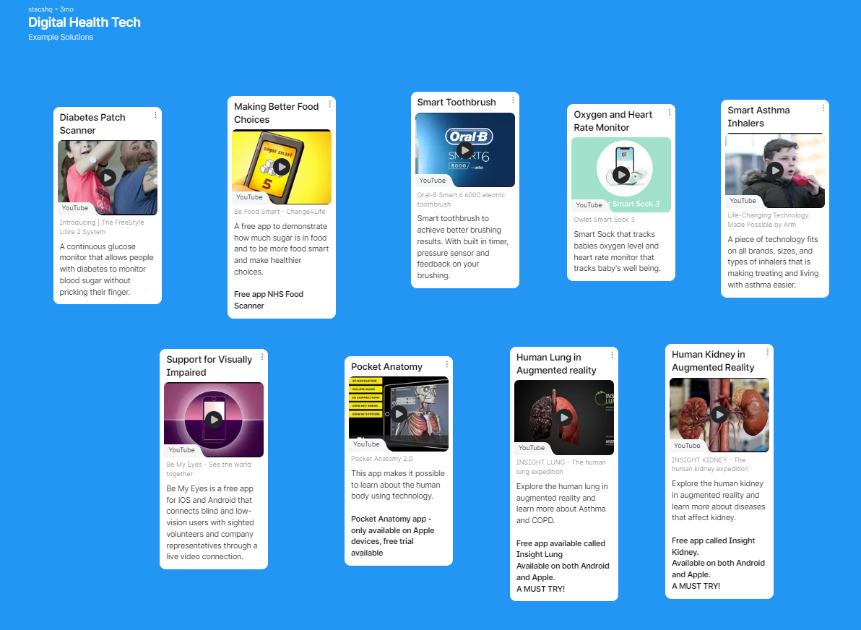
Task 2 – Inspiration
Explore some of these amazing digital technology solutions that already exist
Notes:
TASK 2:
The solution they produce must include technology and there's so many different types of technology out there that could be applied to their solution, raising awareness of the different types of technology will be helpful for pupils and might give them an idea of how it could be used for their solution. This padlet resource is not an exhaustive list of technologies but will be helpful when they are working on their own solutions thinking about what technology they could apply to their solution.
Note: They are not limited to just one type of technology, their solution can use multiple types of technology.
Open bit.ly/DigitalHealthTechExamples (copy and paste into web browser to open a padlet)
This interactive padlet resource has some amazing examples from diabetes patches that track glucose levels and no longer require to prick their finger for a blood test result to smart toothbrushes for better oral hygiene and smart inhalers to help making treating and living with asthma easier.
OPTIONAL TASK 1: You could get the class find different types of technology and create their own Padlet. If you would like to make a copy of the template, you can do this by clicking on the “REMAKE” button then you can share with your class so that everyone can contribute. You can adjust the settings of the board so that pupils can add ideas without needing to login.
This is a class activity where pupils will all contribute and write as many different types of technology that they can think of.
OPTIONAL TASK 2:
You could get pupils to try to find cool examples of technology being used, and explore solutions that already exist for their medical condition.
They might want to look at a new VR headset, headphones, smart doorbells, smart toothbrush etc or could focus them a bit more and give them a theme to look at like smart home technology etc. The purpose of this task is for pupils to see how types of technology is being used in different and exciting ways

Slide 7
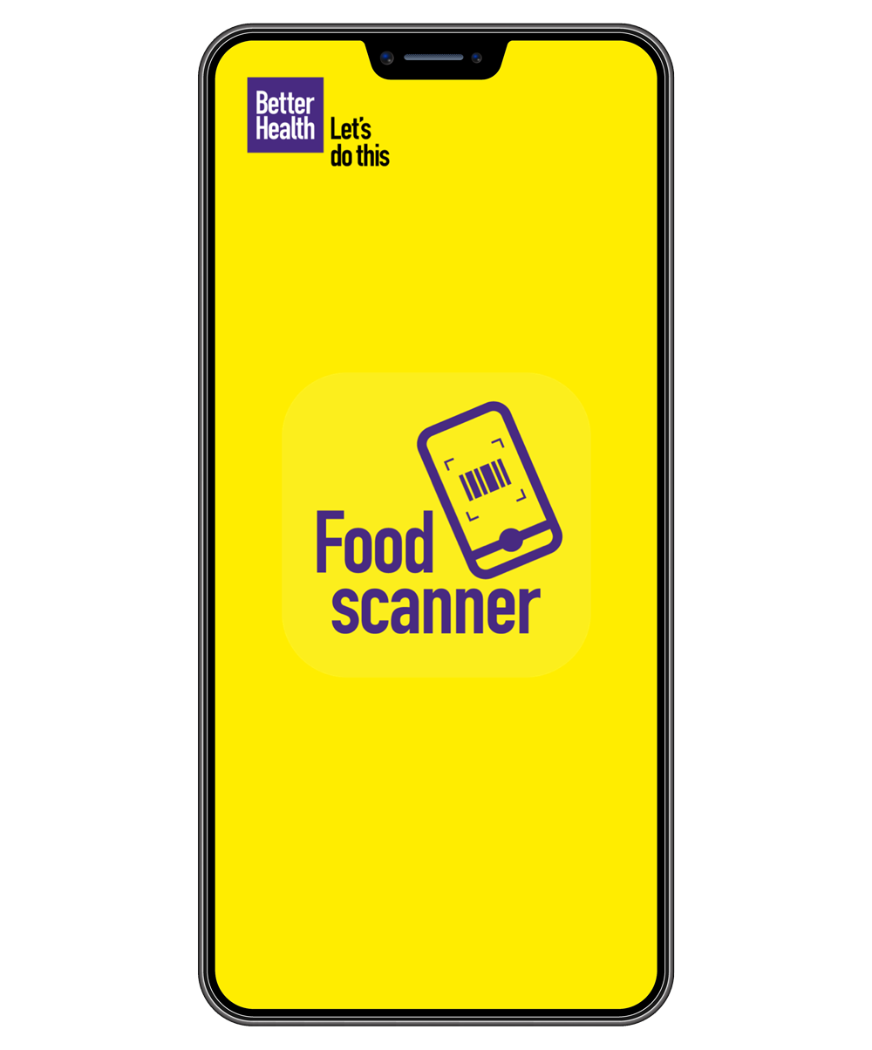
NHS Food Scanner App
NHS Better Health exists to motivate and enable the nation to lead active and healthy lives.
The NHS Food Scanner app brings food labels to life and helps you make healthier choices. Simply scan the barcode to see how much sugar, saturated fat and salt is in your food and drink then choose one of the healthier swap suggestions.
Campaign video (YouTube video)
Putting the NHS Food Scanner App to the test! (YouTube video)
Notes:
Give the children this example of an app that exist to help tackle weight management
NHS FOOD SCANNER APP
NHS Better Health has been created to motivate and enable the nation to lead active and healthy lives.
The NHS Food Scanner app brings food labels to life and helps you make healthier choices. Simply scan the barcode to see how much sugar, saturated fat and salt is in your food and drink then choose one of the healthier swap suggestions.
A quick scan of the barcode on the product's packaging using your phone's camera will show you if it’s a good choice, traffic light ratings, living labels and all previous scans.
Watch the campaign video- 52 sec and Putting the NHS Food scanner App to the test- 2mins
OPTIONAL TASK
You could get the class try the NHS Food Scanner app and raise awareness that this is a free app available on both Google Play and App Store. The purpose behind this is to encourage good food choices and raise awareness of amount of sugar in food.
A fun task, if pupils are allowed in class, use the scanner app and have some everyday snacks and food items that can be scanned or if pupils have any snacks in their bags etc and get them to scan the barcodes (not all products will be found but there is a good selection that is covered).

Slide 8
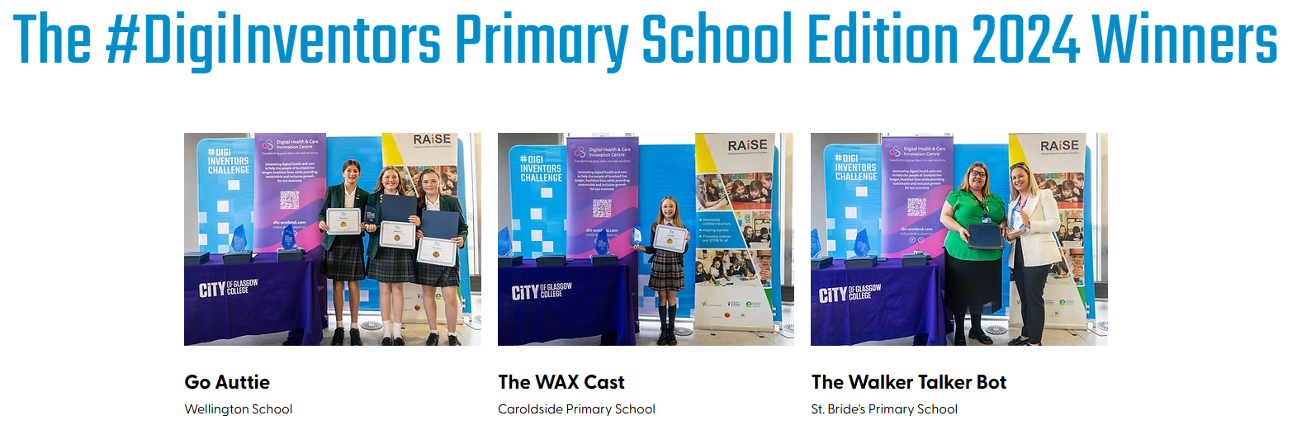
Winning Ideas 2024
Notes:
Giving students an idea of previous entries and winners, look at the image of last year’s entry winners and the titles of their designs (more information on each design in slide 12). There were 3 overall winning teams.
Winners:
Go Auttie: Autism
Wellington School, Ayr
The WAX Cast: broken bones
Carolside PS, East Renfrewshire Council
The Walker Talker Bot: Cystic Fibrosis
P7 St Bride’s Primary School, South Lanarkshire Council
In 2024, all winners attending a prize giving event at City of Glasgow College and were given a certificate, goodie bag and a Sphero indi -a coding robot that lets children learn coding through hands-on play and STEM activities.
Sphero indi video (https://www.youtube.com/watch?v=wWo3QBNPRRE)
*** For 2026 competition, each winning team will receive their own Sphero indi as well as a goodie bag from DHI. ***

Slide 9
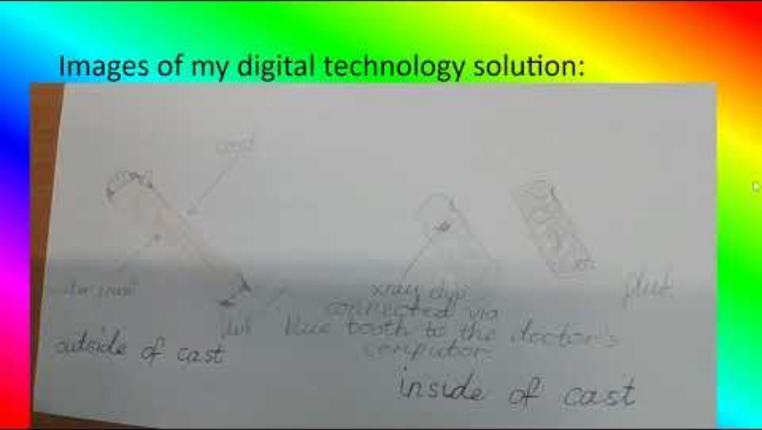
Winning Idea 2024, The Wax Cast
Notes:
Show the video of one last year’s entry winners, The Wax Cast (Carolside PS, East Renfrewshire Council). Discuss this entry with your class and what the elements made it a worthy winning design.
The Wax Cast
The Wax Cast, inspired by the need to improve traditional casts for broken bones. It offers enhanced comfort, a waterproof design, and built-in X-ray technology. With hydrophobic layers, breathable spaces, and a Bluetooth-connected chip, doctors can monitor healing remotely, reducing the need for hospital visits. The
eco-friendly design allows users to bathe, swim, and stay active, ensuring convenience and better healing.

Slide 10
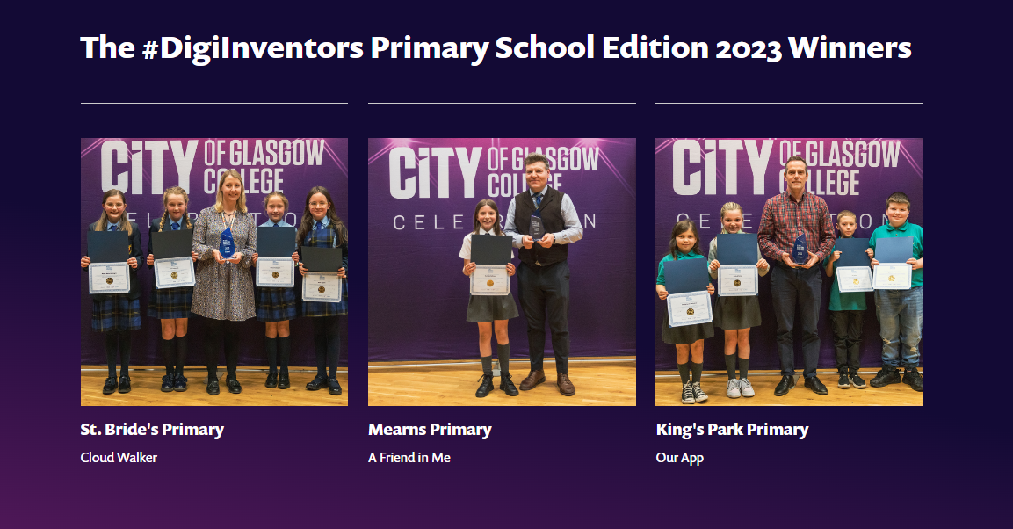
Winning Ideas 2023
Notes:
Look at the image of winners from 2 years ago. Again, discuss the titles and what possible health solutions they address.
In 2023, all winners attending a prize giving event at City of Glasgow College and were given a certificate, goodie bag and a Sphero bolt -a coding robot that lets children learn coding through hands-on play and STEM activities.
Sphero Bolt video (https://www.youtube.com/watch?v=ZluyTRFn3OY)

Slide 11
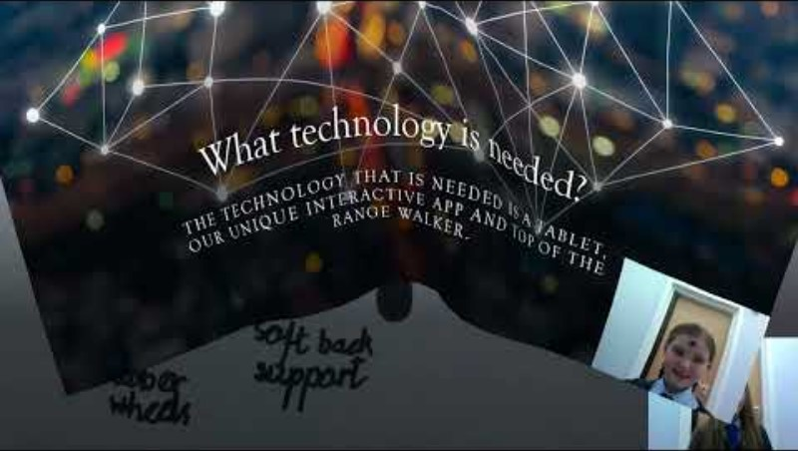
Winning Idea 2023
Cloud Walker - Primary 7
The Cloud Walker is an innovative project developed by a group of students from St. Bride's Primary, aiming to support children with cerebral palsy. This advanced walker combines technology, design, and education, making therapy sessions enjoyable and interactive. With a built-in tablet and app featuring fun games and learning activities, the Cloud Walker promotes overall health, well-being, and skill development. By enhancing the walking and learning experience, it fosters confidence and helps children reach their full potential.
Notes:
This was one of the winning ideas in 2023, The Cloud walker. Tis can be used as an example of a high-quality submission, answering each element of the challenge.
The Cloud Walker is an innovative project developed by a group of students from St. Bride's Primary, aiming to support children with cerebral palsy. This advanced walker combines technology, design, and education, making therapy sessions enjoyable and interactive. With a built-in tablet and app featuring fun games and learning activities, the Cloud Walker promotes overall health, well-being, and skill development. By enhancing the walking and learning experience, it fosters confidence and helps children reach their full potential.
Watch the final presentation video from St Bride’s Primary and use this as an example of a high-quality submission.
https://vimeo.com/816077460

Slide 12
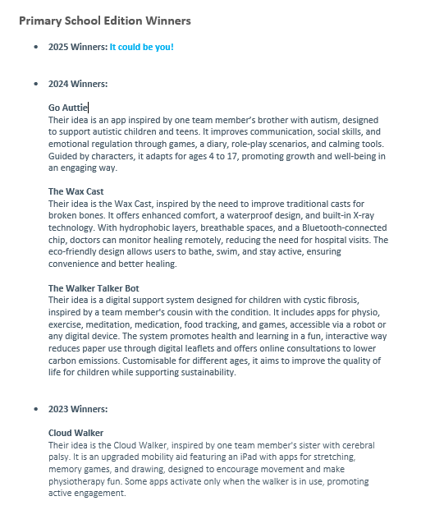
Winning Ideas Examples
Click here for more
Notes:
Optional: Look back at other entry winners from previous years and use the link to read more about each idea. (These entries are all from secondary schools, the primary school challenge started in 2023 and are on the final page of the document)
Find these on DHI website for secondary challenge in ‘teaching resources’

Slide 13
Task 3 – Researching
Take some time to have a think about what health condition your digital health and care idea might support (you can discuss these with your teacher if you are unsure which one to select)
Take some time to research your chosen area on the internet to find out as much background information about this condition as this will help support your design idea
Decide if you would like to enter the competition as an individual, pair or team (remember maximum 4 members in a team)
Notes:
TASK 3:
Pupils will identify the health problem that they would like to solve. They should take some time to do some background reading/ research to give them a deeper understanding of the health condition/ problem they have chosen and how the digital idea might support it.
They will need to decide at this point going forward how they are going to work- individual/ pair/ team of 3 or 4
NOTE
Emphasise that although they have seen many app solutions so far, team entries do not have to be an app design and try to get them to think differently.

Slide 14

Task 3 continued…
Identify a Problem
Decide the problem with the condition that you are going to create a solution for
Complete research around the problem you’d like to solve and gather facts and figures to show how big the problem is and how it is relevant to people
Next step
Now begin to think about how this problem could be solved with digital technology
IMPORTANT: Remember your solution needs to be realistic
JUDGES TIP: Think about what health and care problem does your idea solve?
And why it is important to health and care?
Notes:
TASK 3 CONT.
They should now identify what aspect of the condition their idea will address and begin to research how big this problem is and why it is important to health and care of people.
Example:
Health problem- diabetes
Issue/ aspect of the condition - identifying low blood sugar levels before they become too low and cause for concern/ danger
TASK:
The children should now begin to research the problem, so they understand it more. They should spend some time gathering facts and figures to show how big the problem is and how it is relevant to young people. Individuals/ pairs/ teams could share a document, take notes on paper or slides - whatever is best for your class or each team.
Once the problem is identified, it is now time for them to identify the solution and how digital technology could be used to solve the problem. They should begin to not only think about how the solution would work but create diagrams of what this would look like and annotate it if this helps them. There are lots of tools freely available for pupils to produce digital diagrams or they could use paper if they would prefer.
Some teams might pick a complex issue to solve and might need some help if they think it is too big. Highlight to pupils that they don’t need to solve a whole big problem, but they could produce a small solution that plays a big part of working towards a big goal.

Slide 15
Task 4 – Designing
Start here
Work as an individual or a team to produce your potential idea to solve the problem
If you wish, use the planning document or on paper with same headings
Focus on the following questions:
What healthcare problem will this support?
Why is it important?
Your solution and how it works
What technology is needed?
Does your idea include features that benefit the environment and contribute to achieving net zero carbon emissions?
Activity
During this task, you/ your team will start to think about a solution to the problem you have identified.
IMPORTANT: Ideas should be realistic and unique solutions
Notes:
Once teams have completed their research around the problem they would like to solve, they should now begin to produce their unique solution.
TASK:
To give some structure to this task there is a planning document (linked in slide) that they can use if this helps, or they could use the headings and come up with ideas on paper or whatever tool they would prefer.
Ensure the children have considered:
What health care problem will this support?
Why is it important? (facts and figures)
Your solution and how it works
What technology is needed?
Does your idea include features that benefit the environment and contribute to achieving net zero carbon emissions?

Slide 16
Task 4 – Designing continued…
Things to think about
Finished?
How will people use your solution?
What will it look like?
What technology will it use?
How will it work?
REMEMBER: Describe your idea and how it works, you should try to create something that is clear and helps the judges understand your ideas.
Double check you have covered all criteria
Notes:
If teams are working on their pitch or nearly finished, display this slide as a reminder of the checklist that each team should have completed in order to submit their entry, how they will be judged and how teams will be scored.
Have they considered:
How will people use your solution?
What will it look like?
What technology will it use?
How will it work?
Ensure they have doubled checked all criteria before moving on.

Slide 17
Task 5 – Pitching
Next step:
Now that you/ your team has come up with an idea and finished designing a solution, you can now begin to work on the pitch for your solution
You should create drawings/ diagrams to show what it would look like (no more than 4)
Create a presentation or a video explaining your solution
Options: create a ppt presentation with a voice over or create a video
(both should be no more than 5 minutes long)
Notes:
Once they are happy with their solution, they are ready to start their pitch.
As part of the final pitch, ask them to work together to produce a good quality design(s) (maximum 4 diagrams is allowed). They could draw these images or prepare a digital version and annotating the diagrams will be beneficial.
Take a photo of these images and create a folder that will have all the images pieces of their application in a safe place. These pictures/ photos will be included in their presentation.
For their final entry (their pitch), they should prepare either a ppt with a voice over or create a video explaining their solution. Please note that this should not exceed 5 minutes.

Slide 18
Task 5 – Pitching continued...
Team Activity
What should it include?
Create your team’s pitch for your solution- this will be sent as your entry, so you want to make it look impressive!
#DigiInventors template ppt for entries
What problem of young people’s health your team is trying to solve and why this is important to health and care of young people
How big the problem is (include facts and figures)
What your solution is and how it will work (understanding of the technology used)
Diagrams/ drawings of your solution (no more than 4)
You/ your team should ensure you have completed all of your team’s application questions
Notes:
Either ppt with voice over or a video with children talking through their design and images will be submitted as their final application.
A ppt template is available on this slide should pupils/ teachers wish to use as a guide.
Please ensure a team’s pitch includes:
What problem of young people’s health your team is trying to solve and why it is important to health and care of young people.
How big the problem is (include facts and figures).
What your solution is and how it will work.
Diagrams/drawings of your solution (no more than 4).
IMPORTANT: Teams must answer ensure the 6 application questions are answered within their application. An ideal option would be to use the 6 questions as headings in a ppt presentation or as part of the video.
All entries should be submitted to info@digiinventors.com

Slide 19

What will you be judged on?
Judges are looking for a unique digital solution. They will be specifically looking for what aspects of a young person’s health is being addressed, why it is important to health and care of young people, evidence you have researched and investigated the problem and thought about and how this idea could become a reality.
Judges will score each individual/ pair/ team based on their:
Answers to 6 application questions
PowerPoint or a video presentation explaining/demonstrating how your idea will work (no more than 5 minutes)
Notes:
Judges are looking for a unique digital solution. They will be specifically looking for what aspects of a young person’s health is being addressed, why it is important to health and care of young people, evidence you have researched and investigated the problem and thought about and how this idea could become a reality.
Judges will score each individual/ pair/ team based on their:
Answers to 6 application questions
PowerPoint or a video presentation explaining/demonstrating how your idea will work (no more than 5 minutes)
THE RULES
The rules for the competition are below but also accessible. This information is for teacher/individual delivering this challenge.
The rules state that:
Important dates for this year’s competition are on https://www.dhi-scotland.com/digiinventors-primary
This competition is suitable for second level students in the primary school
Entries can be submitted from an individual, pair or small group
Teams must consist of 1-4 young people at primary school age (maximum 4 children in a team)
Applicants must be attending primary school to be eligible to participate
Each entry must represent a Scottish- based primary school
The name of the school must be stated when registering a team
Each entry must also nominate a responsible adult (most likely class teacher) who will act as the team’s mentor during the #DigiInventorsChallenge process
Parents of team members are not eligible to be mentors in the challenge
All entries must be submitted by email to: info@digiinventors.com
Entries after closing date will not be accepted (closing date is 28th February 2025)
Entries must include application answers, a labelled diagram or illustration showing how their solution will work and a pitch to their solution either a presentation or a video (no more than five minutes duration)
The filenames for each online entry must be the title of the design entry and can be accepted in doc, MP4, WMV, pdf and PPT formats.
Entries must be entirely the work of the individual/ pair/ team submitting the entry
There is no charge for entering the #DigiInventors Challenge
Entries must never have been published on any website, blog or online forum, nor have won or\ been placed (i.e. 2nd, 3rd, runner up etc) in any other competition
Important: Applications should have team name, school, local area and local authority. Student’s names do not need appear on application and if they do, it is the responsibility of teachers to seek parental permission to do so.

Slide 20

What will you be judged on?
In this challenge, the judges are offering teams to earn bonus points if your idea includes features that benefit the environment and contribute to achieving net zero carbon emissions.
Notes:
In this challenge the judges are offering teams to earn bonus points if your idea includes features that benefit the environment and contribute to achieving net zero carbon emissions.

Slide 21

Discover a career in digital health and care
Notes:
To finish, you could show the children this video from DHI, “Discover a career in digital health and care” (1 Minute 44sec)

Slide 22
Curricular links
LIT 2-02a ENG 2-03a | Contributes a number of relevant ideas, information and opinions when engaging with others. Shows respect for the views of others and offers own viewpoint. Builds on the contributions of others, for example, by asking or answering questions, clarifying points or supporting others’ opinions or ideas. Applies verbal and non-verbal techniques in oral presentations and interactions, for example, vocabulary, eye contact, body language, emphasis, pace and/or tone. Recognises some techniques used to engage or influence the listener, for example, vocabulary, emphasis, tone and/or rhetorical questions.
LIT 2-09a LIT 2-10a | Communicates clearly, audibly and with expression in different contexts. Plans and delivers an organised presentation/talk with relevant content and appropriate structure. Uses suitable vocabulary for purpose and audience. Selects and uses resources to support communication.

Slide 23
Curricular links
MTH 2-12a | Researches and presents examples of the impact mathematics has in the world of life and work. Contributes to discussions and activities on the role of mathematics in the creation of important inventions, now and in the past.
SCN 2-20a | Describes the impact of scientific discovery, creativity and invention on society past and present, for example, in design, medicine and agriculture. Demonstrates understanding of how science impacts on every aspect of our lives. Relates the development of scientific skills in the classroom to an increasingly wide variety of science, technology, engineering and mathematics (STEM) careers.
HWB 2-13a | Through contributing my views, time and talents, I play a part in bringing about positive change in my school and wider community
HWB 2-19a | Opportunities to carry out different activities and roles in a variety of settings have enabled me to identify my achievements, skills and areas for development. This will help me to prepare for the next stage in my life and learning

Slide 24
#DigiInventors Challenge 2026 - Primary
05/01/2026 Challenge launches and teaching resources are available for use - teachers are encouraged to use the next 8 weeks to work with pupils to research
27/02/2026 Application submission deadline - our judges will use the next 2 weeks to select our winners and runners-up
23/03/2026 Winners and runners-up announced
28/04/2026 Award Ceremony at City of Glasgow College
Notes:
Date for #DigiInventors Challenge 2026

