Slide 1
#DigiInventors Challenge 2025
Secondary School Competition
Teacher & Pupil guide
Notes:
TOPIC - DIGITAL HEALTH TEACH #DigiInventors Challenge
Objectives
Learn digital, entrepreneurial and design innovation skills
Raise awareness of exciting career opportunities in the digital health and social care sector
Identify a health challenge and create a digital health solution of their very own using their newly learned digital, entrepreneurial and design innovation skills
SETUP
The set of slides includes pick-up and play unit of work, along with teachers’ notes and breaks the #DigiInventors Challenge into smaller tasks that will all feed into elements needed for a team entry.
@DigiInventors is active on Bluesky and Instagram so feel free to share pictures & posts of your classes taking part in this year’s challenge using the hashtag #DigiInventors
PURPOSE
Pupils will have a chance to explore and think about how technology is used in health solutions and working in teams, pupils will get to design a solution of their own and take part in the #DigiInventors Challenge competition.

Slide 2
The #DigiInventors 2025 Challenge
Notes:
The Challenge | Digital Health & Care Innovation Centre

Slide 3
#DigiInventors Toolkit
Please find quick access to all important documents, templates & resources!
Word doc answers template – Please save a COPY before editing!
Website page resources
Application form
2025 Rules
Privacy notice
Website
Notes:
These are the core essential documents and links required to take part in the competition – for any questions or access issues email: info@digiinventors.com

Slide 4
What is the challenge?
Develop a digital solution for a health, care or wellbeing issue as defined in either challenge option question 1 or 2 (Just select one of the options for this challenge)
Learners work in teams to:
Research the health problem
Create a digital solution
Create a prototype or mock-up of your solution
Create a 1-minute (60 seconds) video to pitch your idea
Submit your application
Notes:
Scotland Women's National Football Team | SWNT | Scottish FA
ACTIVITY TYPE: Introduction to competition - #DigiInventors Challenge details
PROMPTS
We are going to be exploring digital health technology, so this is where technology is used to help come up with better health and wellbeing solutions.
This year’s Challenge has 2 questions:
One based on Scottish Women’s Football
One based on a general health and social care challenge of your choice
Judges are looking for unique tech solutions. They want to know why your solution is unique and is it important to the health and care of the young people, evidence you have research and looking into the problem and thought about how this idea could become a reality and be scaled so all young people can benefit from it.
You need to answer a series of questions, submit a visual and a 1-minute elevator pitch as part of your submission
OBJECTIVES
Understanding of the competition details and entry requirements
-----------------------------------------------------------------------------------------------------------------------------------------------------------------------------
TEACHER INFORMATION ABOUT RULES OF COMPETITION:
The rules for the competition are below. This information is for teacher/individual delivering this challenge the only one I would mention to pupils is the last one just in case any pupils have been involved in similar competitions and may want to use a previous entry.
The rules state that:
Important dates for this year’s competition are on (all information is on (The Challenge | Digital Health & Care Innovation Centre)
Teams will consist of a maximum of 6 young people at secondary school
Team members must be attending secondary school to be eligible to participate
Each team must represent a Scottish or UAE based secondary school, organisation or club
The name of the school or youth organisation must be stated when registering a team
Each team must also nominate a responsible adult (over the age of 21) who will act as the team’s mentor during the #DigiInventors Challenge process.
Parents of team members are not eligible to be mentors in the challenge
All entries must be submitted using the online submission form on the DigiInventors Challenge website (www.digiinventors.com)
Entries after closing date will not be accepted (closing date is on The Challenge | Digital Health & Care Innovation Centre)
Entries must be entirely the work of the team submitting the entry
There is no charge for entering the #DigiInventors Challenge
Entries must never have been published on any website, blog or online forum, nor have won or\ been placed (i.e. 2nd, 3rd, runner up etc) in any other competition

Slide 5

What is the #DigiInventors Challenge
Notes:
ACTIVITY TYPE: Video
Video length: 1 minutes 7 seconds
Link to video – https://vimeo.com/1104096835
VIDEO PROMPTS
- The Digital Health & Care Innovation Centre have together launched the #DigiInventors Challenge where you will work in teams of up to 6 people to identify a health challenge that you would like to fix and come up a solution that uses digital technology or tackle our partner set question!
- Here is a short video that explains a bit more about what #DigiInventors is.

Slide 6

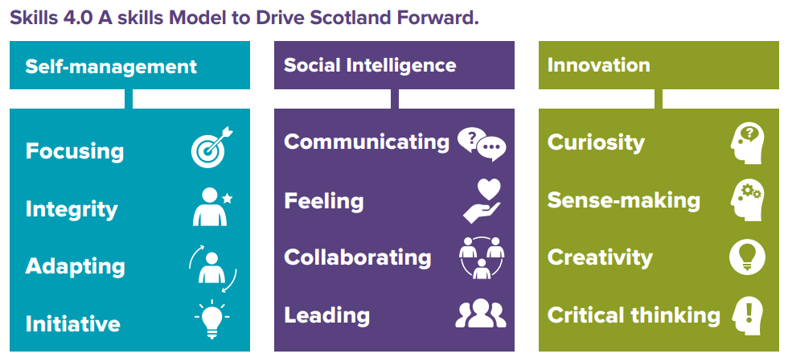




What do your pupils get from the Challenge?
Learn new skills
Accreditation
Experience for CV
Support from peers (national and international)
Master’s Students, Industry Mentors & Entrepreneurs
Career insights
* Young STEM Leaders Level 4 Award
Notes:
* Young STEM Leader Awards are currently only available in Scotland
You will help to build a better society and communities
If you get through to the bootcamp stage and the grand final
Support from Master’s students, industry mentors and entrepreneurs
A chance to compete with international teams
Win The coveted #DigiInventors trophy, certificates, goodie bags and tech prizes for your team
Your teacher or mentor will be excited to see you reach for the stars too!

Slide 7
Who can apply?
The #DigiInventors Challenge 2025 is open to:
Teams of up to six learners
Learners in S1 to S6 (ages 12 – 18 years)
Teams can be in mixed age groups
2025 Rules
Notes:
ACTIVITY TYPE: Introduction to competition - #DigiInventors Challenge details
PROMPTS
We are going to be exploring digital health technology, so this is where technology is used to help come up with better health and wellbeing solutions.
This year’s Challenge has 2 questions – you can choose which question you wish to answer:
One based on Scottish Women’s Football
One based on a general health and social care challenge of your choice
Judges are looking for unique tech solutions. They want to know why your solution is unique and is it important to the health and care of the young people, evidence that you have researched and looked into the problem and thought about how this idea could become a reality and be scaled so all young people can benefit from it.
You need to answer a series of questions, submit a visual and a 1-minute elevator pitch as part of your submission
OBJECTIVES
Understanding of the competition details and entry requirements
-----------------------------------------------------------------------------------------------------------------------------------------------------------------------------
TEACHER INFORMATION ABOUT RULES OF COMPETITION:
The rules for the competition are below. This information is for teacher/individual delivering this challenge the only one I would mention to pupils is the last one just incase any pupils have been involved in similar competitions and may want to use a previous entry.
The rules state that:
Important dates for this years competition are on (all information is on (The Challenge | Digital Health & Care Innovation Centre)
Teams must consist of a maximum of 6 young people at secondary school
Team members must be attending secondary school to be eligible to participate
Each team must represent a Scottish or UAE based secondary school, organisation or club
The name of the school or youth organisation must be stated when registering a team
Each team must also nominate a responsible adult (over the age of 21) who will act as the team’s mentor during the #DigiInventors Challenge process.
Parents of team members are not eligible to be mentors in the challenge
All entries must be submitted using the online submission form on the DigiInventors Challenge website (Apply | Digital Health & Care Innovation Centre)
Entries after closing date will not be accepted (closing date is on (The Challenge | Digital Health & Care Innovation Centre)
Entries must be entirely the work of the team submitting the entry
There is no charge for entering the #DigiInventors Challenge
Entries must never have been published on any website, blog or online forum, nor have won or\ been placed (i.e. 2nd, 3rd, runner up etc) in any other competition

Slide 8

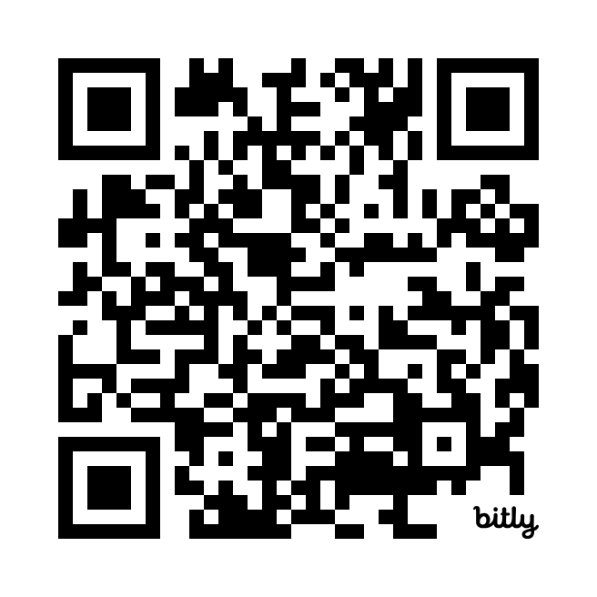
Option 1: Scottish Women’s Football Challenge
Develop a digital idea that is easy to use and targeted towards a female audience:
Challenges stereotypes
Attracts girls and women to get involved in playing football
And how can this solution help educate and inform them about leading healthy lifestyles (both physically and mentally)?
Real-life challenge Read the report
Notes:
Scotland Women's National Football Team | SWNT | Scottish FA
ACTIVITY TYPE: Introduction to competition - #DigiInventors Challenge details
PROMPTS
We are going to be exploring digital health technology, so this is where technology is used to help come up with better health and wellbeing solutions.
This year’s Challenge has 2 questions:
One based on Scottish Women’s Football
One based on a general health and social care challenge of your choice
Judges are looking for unique tech solutions. They want to know why your solution is unique and is it important to the health and care of the young people, evidence you have research and looking into the problem and thought about how this idea could become a reality and be scaled so all young people can benefit from it.
You need to answer a series of questions, submit a visual and a 1-minute elevator pitch as part of your submission
OBJECTIVES
Understanding of the competition details and entry requirements
-----------------------------------------------------------------------------------------------------------------------------------------------------------------------------
TEACHER INFORMATION ABOUT RULES OF COMPETITION:
The rules for the competition are below. This information is for teacher/individual delivering this challenge the only one I would mention to pupils is the last one just incase any pupils have been involved in similar competitions and may want to use a previous entry.
The rules state that:
Important dates for this years competition are on (all information is on (The Challenge | Digital Health & Care Innovation Centre)
Teams must consist of a maximum of 6 young people at secondary school
Team members must be attending secondary school to be eligible to participate
Each team must represent a Scottish or UAE based secondary school, organisation or club
The name of the school or youth organisation must be stated when registering a team
Each team must also nominate a responsible adult (over the age of 21) who will act as the team’s mentor during the #DigiInventors Challenge process.
Parents of team members are not eligible to be mentors in the challenge
All entries must be submitted using the online submission form on the DigiInventors Challenge website (www.digiinventors.com)
Entries after closing date will not be accepted (closing date is on (The Challenge | Digital Health & Care Innovation Centre)
When submitting ensure it’s not locked in school systems e.g. (Glow) as we cannot view or access PP from there.
Entries must be entirely the work of the team submitting the entry
There is no charge for entering the #DigiInventors Challenge
Entries must never have been published on any website, blog or online forum, nor have won or\ been placed (i.e. 2nd, 3rd, runner up etc) in any other competition

Slide 9
Reason for Option 1
This is a real-life challenge that Scottish Women’s Football are trying to address – they are excited to see what solutions your team identifies. Read the report
UEFA European Women's Championship took place from 02-27 July 2025 in Switzerland
Women’s football is becoming increasingly popular with more people participating, watching and supporting teams
Notes:
Report link - https://www.actify.org.uk/module/454

Slide 10
Option 2: General health challenge
Identify a real-life problem related to people’s health or wellbeing, and develop a digital idea to help solve it
Identify a health and wellbeing challenge, personal to your team (Could affect you, family member or friend)
OR
Other suggestions to consider:
Health & wellbeing – Physical Activity, Obesity/ Weight Management, Diabetes, dental health, ageing
Disability – Blindness, Deafness, Neurodiversity and Learning Disabilities (including Autism, ADHD, Dyslexia, Dyscalculia, Dyspraxia)
Cardiovascular diseases – Hypertension, Heart Disease, Cerebrovascular Disease (Strokes), Peripheral Vascular Disease
Mental health – Anxiety, Depression
Neurological diseases – Brain injuries, Epilepsy, Parkinson’s Disease, Multiple Sclerosis
Gastrointestinal diseases – Crohn’s Disease, Cystic Fibrosis
Respiratory diseases – Asthma, COPD
Addictions – drugs, alcohol, vaping, cigarettes
Rural and remote – access to healthcare in rural and remote areas & island communities
Other – Cancer, Arthritis, Kidney Disease, Long Covid, Alzheimer’s Disease, Paralysis

Slide 11
Reason for Option 2
The options are all global health and social care challenges
The options are all challenges that DHI is or has had projects
But
You can also choose a health and social care challenge/ condition that means something (personally) to your team
Notes:
Report link - https://www.actify.org.uk/module/454

Slide 12
The Prize(s)
All participants who actively take part in the challenge and whose submission answers all the requirements will receive a #DigiInventors Challenge completion certificate and a Young STEM Leaders Level 4 (non-formal) award*
From the applications submitted, finalist teams will be selected. They will:
Receive #DigiInventors Challenge goodie bags
Attend a two-day bootcamp (in Scotland and the UAE)
Present to our panel of judges before the winners are selected
The winning teams will receive:
Technology prize (previous prizes included iPads)
#DigiInventors Challenge Certificate
Trophy + Insight points for your school
Scottish Women’s Football prize
SSERC YSL Level 4 formal award*
* Young STEM Leader Awards are currently only available in Scotland
Notes:
https://www.youngstemleader.scot/

Slide 13
#DigiInventors Challenge 2025 Timeline
Launch of Challenge
Scotland – 18/08/25
United Arab Emirates (UAE) – 25/08/25
Application close and finalists announced
10/10/25 – Application closes
24/10/25 – Finalists announced
Finalist's presentations
Final presentations – 08/12/25
Winners announced – 11/12/25
August 2025
September 2025
October 2025
November 2025
December 2025
Working on the challenge
Research, creating a digital solution to a health issue
Finalists bootcamp
Two-day bootcamp for finalist teams 17/11/25 & 18/11/25
Final Awards Ceremonies February 2026

Slide 14

What is digital health and social care?
Digital and data infrastructures
Wearable and mobile devices and monitors
Digital health and care systems
Telehealth and telecare solutions
Telemedicine
Personalised care
Data analytics
Cybersecurity
Artificial Intelligence and the Internet of Things (IoT)
Digital health and social care solutions include:
Digital Health & Social Care in Scotland is about transforming how services are delivered - through national infrastructure, secure data sharing, workforce training, and innovative care models - all underpinned by strong leadership and a strategy focused on fairness and citizen empowerment.
The goal? Better, more accessible care tailored to individuals, supported by technology.

Slide 15

Why is digital health and social care Important?
Faster help
More access
Better health tracking
Support for carers
Saves time and money
In short, digital health and social care make care smarter, quicker, and more personal. It's about using tech to make life healthier, safer, and easier for everyone.
Notes:
Imagine if you could talk to a doctor on your phone, get reminders to take your medicine from an app, or use a smartwatch to track your heart rate. That’s digital health - using technology to help people stay healthy and get the care they need.
Social care helps people who need extra support in their daily lives, like the elderly, people with disabilities, or those who are recovering from illness. When we add technology to social care, like smart devices that remind someone to eat or take medicine, we call it digital social care.
Faster help: Doctors can check your symptoms or test results quickly through apps or video calls.
More access: Even if someone lives far away from a hospital, they can still get the help they need online.
Better health tracking: Devices and apps can help people monitor their health every day, not just when they visit a doctor.
Support for carers: People who look after others (like family members or social workers) can use technology to make sure their loved ones are safe and well.
Saves time and money: Digital tools help reduce long wait times and avoid unnecessary travel or appointments. It can help reduce pressure on health and care services.

Slide 16

About the Digital Health & Care Innovation Centre (DHI)
Notes:
Information on the work of the Digital Health and Carse Innovation centre
This includes the design processes they use and how they work with partners to develop technology solutions and emerging technologies across health care.
Additional link for further information in digital health care innovation - Journey - Animated Short - DHI 10 Years on Vimeo
https://vimeo.com/877847336

Slide 17
What do your pupils get from the Challenge?
Learn new skills
Accreditation
Experience for CV
Support from peers (national and international)
Master’s Students, Industry Mentors & Entrepreneurs
Career insights
* Young STEM Leaders Level 4 Award
Notes:
* Young STEM Leader Awards are currently only available in Scotland
You will help to build a better society and communities
If you get through to the bootcamp stage and the grand final
Support from Master’s students, industry mentors and entrepreneurs
A chance to compete with international teams
Win The coveted #DigiInventors trophy, certificates, goodie bags and tech prizes for your team
Your teacher or mentor will be excited to see you reach for the stars too!

Slide 18
Young STEM Leader Programme
The Young STEM Leader Programme (YSLP) enables young people in Scotland to inspire, lead and mentor their peers through the delivery of STEM activities, events or interactions within their learning communities.
As well as developing important leadership, communication and employability skills, completing a Young STEM Leader award will motivate young people to progress their STEM studies leading towards positive destinations in STEM.
Above all, the Programme aims to promote curiosity in STEM, allowing Young STEM Leaders to learn about the world around them in a fun, engaging and accessible way.
Notes:
Informal Level 4 award for all applicants who provide evidence - Non-formal | Young STEM Leader
Level 5 award available for those that progress into the bootcamp and final - Formal | Young STEM Leader

Slide 19
What does DHI & Partners get from the Challenge?
Great ideas to share with our partners like Scottish Women’s Football
More children and young people considering careers in digital health and social care
Opportunity to strengthen important international links
Potential talent pipeline – developing the digital health and social care professionals, innovators and entrepreneurs of the future
Letting Scotland flourish – inward investment and relocation, and showcasing Scotland on the world stage

Slide 20

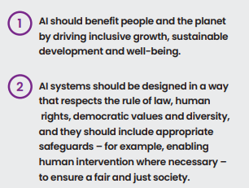
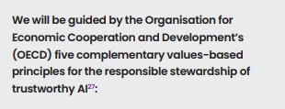
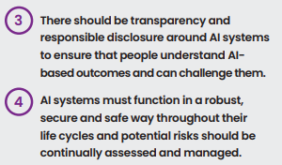
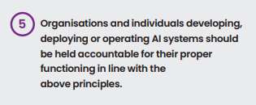
Scotland's AI strategy highlights
Notes:
Key highlights from the AI strategy ethical approach.

Slide 21

What should you think about?
Your team should select which challenge question you will answer – challenge option question 1 or 2
How could your idea use artificial intelligence (ai)
Your idea should make a real difference to people’s lives
Your idea must involve digital technology
Think about how your idea could also help the planet –UN sustainable development goals
Notes:
Come up with an original idea — it can be a completely new and novel idea or an adaptation or enhancement of an existing solution.
Your idea must involve digital technology – it could be an app, a game, a smart device, something wearable, sensors, hardware/software or a way to connect with others
How could your idea use Artificial Intelligence (AI), and does it align with Scotland’s AI Strategy
Think about how your idea could also help the planet – it should align with the UN Sustainable Development Goals and/ or help reduce carbon emissions
Your idea should make a real difference to people’s lives

Slide 22

Judging criteria - overview
Section 1
Problem and Idea
Section 2
Research and Insight
Section 3
Design and Impact
Section 4
Communication and Pitch
You will have a maximum of 400 words for each criteria section
The application form is online
Word document template is available to teams to use to capture their research and findings

Slide 23
Judging criteria 1 – Problem and idea
Problem and Idea (Worth 8 points)
Tell us about your idea and the problem it solves
Is your idea original and creative? What inspired it?
Have you clearly explained the health or well-being problem/challenge question you're tackling?
Is it obvious how your idea solves that problem?
Have you explained who it will help and how?

Slide 24
Judging criteria 2 – Research and insight
Research and Insight (Worth 4 points)
Show us the research behind your idea
Have you backed up your idea with facts, statistics, or evidence?
Have you used any insights from real users or examples?
Is your research clearly linked to your problem and solution?

Slide 25
Judging criteria 3 – Design and impact
Design and Impact (Worth 8 points)
Explain what your idea looks like and the difference it will make
What impact will it have on the people using it?
Have you included a visual or prototype that clearly shows your idea?
Have you considered if it’s inclusive and accessible for everyone?
Does your idea consider the environment, fairness (ethics), or use of technology like AI? How does it relate to the UN’s Sustainable Development Goals?

Slide 26
Judging criteria 4 – Communication and pitch
Communication and Pitch (Worth 4 points)
Tell your story with confidence!
Is your explanation clear and easy to understand?
Is your video pitch compelling and does it summarise your idea and its impact?
Make sure you stick to the 1-minute elevator pitch limit!
Not everyone has to present in the video!

Slide 27

Step 1: Create your team
Identify your teammates
Select a name for your team
Discuss and share your skills and interests
Allocate team member roles
Set ground rules about how your team will work
What do you want to achieve as a team?

Slide 28

Step 2: Identify the problem
Select challenge option 1 or 2
Identify the problem that may affect young people in your chosen challenge area
As a group, decide which problem you are going to create a solution for
Aligned to judging criteria 1
Notes:
ACTIVITY TYPE: Practical task pairs/small groups
TASK - IDENTIFY PROBLEM
- Each group should identify a problem and a solution around how to improve the health and wellbeing of young people
- Then research what problems they would like to solve, it must be relevant to young people’s health in Scotland.
- Once they have identified a problem they will solve. Each group should begin to research the problem so they understand it more. Gathering facts and figures to show how big the problem is and how it is relevant to young people.
- Groups could share a document, take notes on paper or slides whatever is best for your class or each team.
- All of this will be part of their final pitch.
PROMPTS
- Working in teams, pupils will identify the health problem that they would like to solve. They should identify what aspect of a young person’s health it will address and begin to research how big this problem is and why it is important to the health and care of young people.
- Be creative. Your solution doesn’t have to be an app or a website. It could be a physical device that you carry in your pocket, a patch on your skin anything you want.
OPTIONAL 5 WHYS TASK
- Some teams might have picked a really complex issue to solve and might need some help if they think it is too big.
- To help them think about the root causes of some of their problem a useful technique to use it the 5 whys
- Ask “why?” five times in a continuous sequence to help them discover the root cause of a problem.
- Each time you ask why a problem occurred, your answer then becomes the premise of your next question, forcing you to dig deeper and deeper into the true cause of the issue.
- Useful to stress to pupils that they don’t need to solve a whole big problem but they could come up with a small solution that plays a big part of working towards a big goal like that.
- For example, help reduce the anxiety of joining a sports team etc
EXTENSION TASK PROMPTS
- It is now time for them to identify the solution and how technology could be used to solve the problem.
- Begin to think about how the solution would actually work and create diagrams or what this would look like and annotate it if this helps them.
- There are lots of tools free available for pupils to come up with diagrams or they could use paper if they would prefer.
USEFUL FREE WIREFRAME TOOL:
- Mockup, great tool for designing wireframes and supports online collaboration so teams can work together.
Here is a short (4 min 17 seconds) video for teachers to see how to use it so can do a quick live demo with any groups who this tool might be useful for.
Canva also has great mock up tool and PowerPoint templates
OBJECTIVES
- Gain a deeper understanding of the health-related problem they are going to be solving.

Slide 29
Step 3: Research the problem
Research your chosen problem that may affect young people in your chosen challenge area.
Complete research around the problem you’d like to solve:
  Gather facts and figures to show how big the problem is
  How it is relevant to young people?
Aligned to judging criteria 2
Notes:
ACTIVITY TYPE: Practical task pairs/small groups
TASK - IDENTIFY PROBLEM
- Each group should identify a problem and a solution around how to improve the health and wellbeing of young people
- Then research what problems they would like to solve, it must be relevant to young people’s health in Scotland.
- Once they have identified a problem they will solve. Each group should begin to research the problem so they understand it more. Gathering facts and figures to show how big the problem is and how it is relevant to young people.
- Groups could share a document, take notes on paper or slides whatever is best for your class or each team.
- All of this will be part of their final pitch.
PROMPTS
- Working in teams, pupils will identify the health problem that they would like to solve. They should identify what aspect of a young person’s health it will address and begin to research how big this problem is and why it is important to the health and care of young people.
- Be creative. Your solution doesn’t have to be an app or a website. It could be a physical device that you carry in your pocket, a patch on your skin anything you want.
OPTIONAL 5 WHYS TASK
- Some teams might have picked a really complex issue to solve and might need some help if they think it is too big.
- To help them think about the root causes of some of their problem a useful technique to use it the 5 whys
- Ask “why?” five times in a continuous sequence to help them discover the root cause of a problem.
- Each time you ask why a problem occurred, your answer then becomes the premise of your next question, forcing you to dig deeper and deeper into the true cause of the issue.
- Useful to stress to pupils that they don’t need to solve a whole big problem but they could come up with a small solution that plays a big part of working towards a big goal like that.
- For example, help reduce the anxiety of joining a sports team etc
EXTENSION TASK PROMPTS
- It is now time for them to identify the solution and how technology could be used to solve the problem.
- Begin to think about how the solution would actually work and create diagrams or what this would look like and annotate it if this helps them.
- There are lots of tools free available for pupils to come up with diagrams or they could use paper if they would prefer.
USEFUL FREE WIREFRAME TOOL:
- Mockup, great tool for designing wireframes and supports online collaboration so teams can work together.
Here is a short (4 min 17 seconds) video for teachers to see how to use it so can do a quick live demo with any groups who this tool might be useful for.
Canva also has great mock up tool and PowerPoint templates
OBJECTIVES
- Gain a deeper understanding of the health-related problem they are going to be solving.

Slide 30
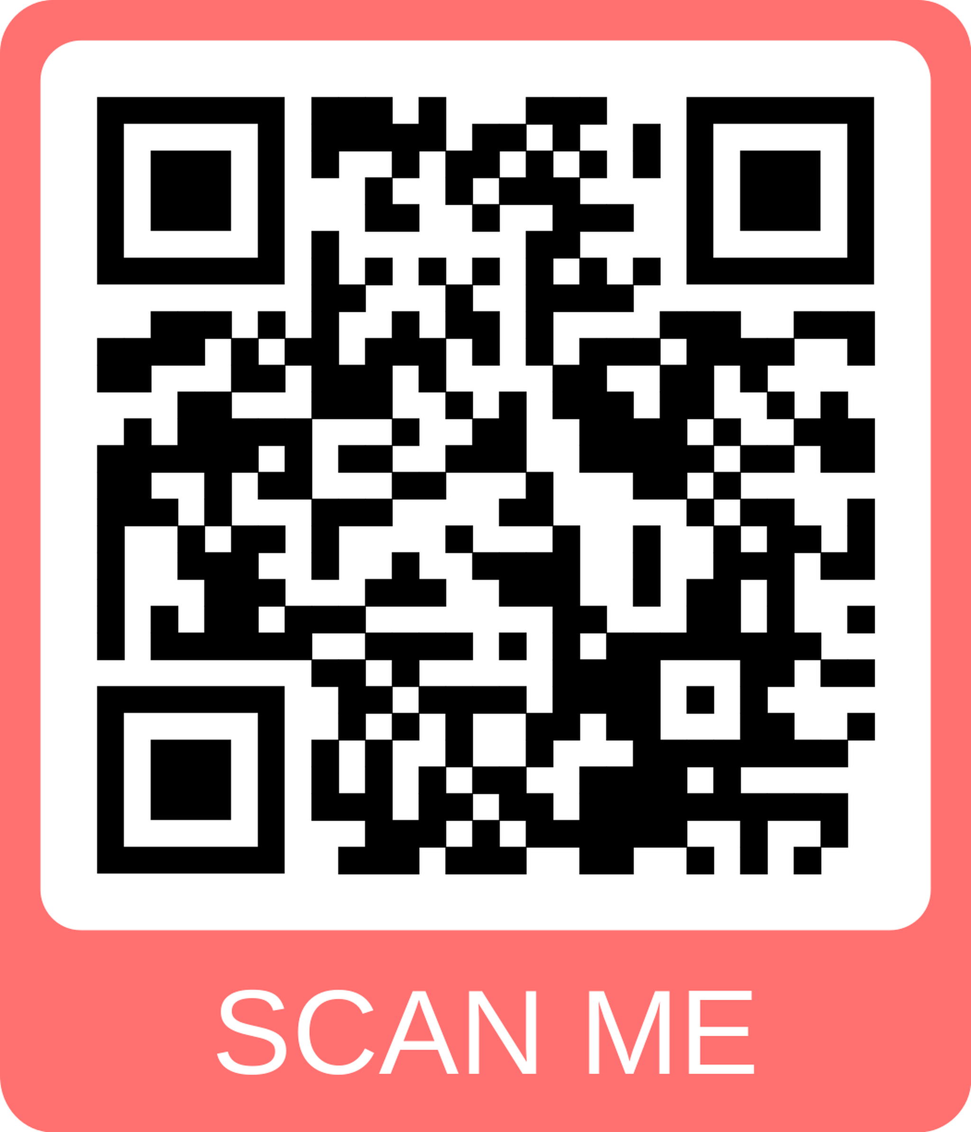
Resources
There are lots of resources on the #DigiInventors Challenge website to help with your research and developing your ideas.
These have been tagged as “essential resources” and “additional resources” – it is up to you to decide if and how much of them you use
Different resources will align with different judging criteria areas

Slide 31

Step 4: Designing a solution
WORK AS A TEAM
Produce potential ideas to solve the problem.
Focus on the following questions:
What health and care problem does it solve?
Why is this important?
Your solution and how it works.
What technology is needed? For some ideas go to:
bit.ly/DHIExploringTechnology
THINGS TO THINK ABOUT
How will people use your solution?
What will it look like?
How will it be used?
What technology will it use?
How will it work?
FINISHED? Remember you must…….
Come up with an idea, do your research, and design your solution. Then it’s time to answer the mandatory questions
You must create one prototype concept visual
Record a 1-minute elevator pitch
Submit all the above via the website
Aligned to judging criteria 3
Notes:
Other resources that may be useful for professional learning and for supporting pupils through a design process approach can be found here:
Engineering Habits of Mind – STEM Nation

Slide 32
Step 5: Pitch your solution
Create a 1-minute elevator pitch.
  This will get sent as part of your entry.
  Option of recording it with voice over or a video (no more than 1 minute).
It should include:
Which Challenge Option Question did you address and why?
What health problem your team is trying to solve and why it is important to health and care?
How big the problem is (include facts and figures)
What your solution is and how it will work (understanding of technology that will be used)
Prototype concept or mock-up – Include in the video
What impact will it have
Link to all four criteria
Aligned to judging criteria 4
Notes:
Pitching advice
Introduce yourself, say what you have selected and why
Say your name, which challenge have you addressed and why.
2. Add some captivating details about your idea
Mention something that makes your idea unique. It can be a quick story about the health problem you're solving and why its important. Add your fact and figures, an interesting finding you uncovered recently that might be relevant.
3. Your solutions
You have the solution – been bold with it! Get excited as you explain it. Use a visual prototype to help explain and be enthusiastic about what it does.
4. Use the ending of your pitch as an opportunity for you leave a lasting impression
Try to make your listeners feel like they would be missing out not investing in you – share the impact your idea could have on the health of others.
Presentation skills advice
Positioning: Think about where you will be presenting. What space do you have available? How will you as a team position yourself? Will you all stand in a line? Around a central point? Will you step forward to speak or speak where you stand?
Slightly different when you are on screen but you should still consider your space. Background, interruptions, connectivity etc. Where will you have your notes? Notes page? On paper. Where to look. This needs to be decided in advance and practiced.
Body language: Body language is to do with the attitude that you display by the way you hold your body. For example crossed arms –can be seen as defensive as you are holding yourself in closed position.
If you have your feet crossed in front of you, again this is closed. If you have your head down – it looks disinterested. If you have your weight balanced on one hip, it looks carefree and that you are not interested in what you are saying.
You should have an open body language – that makes you look approachable and focussed.
Use of gesture: Is using your hands to convey feeling, emotion or intent. Use of gesture is good to help make and emphasise a point you are making. When we are truly engaged in conversation with friends or family, or we are passionate about something we are talking about, we naturally use our hands to make a point or show a particular emotion or mood. It is the same with a presentation. Where would it assist your presentation to use appropriate gesture? Consider this when you are delivering your pitch.
Use of voice: Our voices let someone listening how we are feeling and emotion we are trying to explain.
Tone - is the emotion you are trying to convey. Example - Happy, excited, sad, angry, light-hearted etc.
Pitch – is the height or depth of your voice. Example – high or low
Pace – is the speed of your voice. Example- fast, slow, moderate, very low, very fast.
Volume – is the loudness or softness of the voice. Example – shouting to a whisper
Clarity – is how clearly the voice is heard and understood. Example – hearing the t’s of words, opening your mouth to articulate your words.
Consider how you use your voice to engage your judges.

Slide 33

Applying and submitting
Prepare your application in the Word template, making sure all sections are completed fully, including the four application questions
Prepare your one prototype/mock-up in advance and take a picture of it
Make sure your 1-minute pitch video has been uploaded and is available online.
Prepare your SSERC Young STEM Leaders Programme declaration and make sure all sections have been completed and signed by your teacher/mentor.
Cut and paste text, upload prototype/mock-up picture and link to pitch video into the online application form: insert LINK
You can choose to take part in the Young STEM Leaders declaration by ticking this on the online form & next steps will be shared!
Don’t leave it to the deadline on 10 October – submit in advance just in case
Notes:
Apply | Digital Health & Care Innovation Centre

Slide 34
Top tips from our judges
Be creative with your video! Remember the video must be 60 seconds maximum.
Demonstrate detailed research and provide an in-depth account to the four questions. Use the word document template to collate your thoughts and answers to each of the sections.
Make your prototype concept visual, clear and easy to understand
Make sure you upload your video correctly, and there are no permission issues for external judges to access.
If your video cannot be accessed or is more than 60 seconds, it will be discounted from the scoring
Notes:
Not all team members need to appear in the 1-minute elevator pitch video – use your time wisely and play to everyone’s strengths
ACTIVITY TYPE: Reminder of entry requirements
PROMPTS
- Reminder of entry requirements for competition
- If teams are working on their pitch or nearly finished, I would tend to display this slide as a reminder of the checklist that each team should have completed in order to submit their entry, how they will be judged and how teams will be scored.
OBJECTIVES
- Understanding of the competition details and entry requirements.

Slide 35

Inspiration – Previous examples
Real projects that DHI has delivered and scaled across Scotland
Previous #DigiInventors Challenge winning ideas
Other digital health and care solutions
Notes:
The following slides may be useful when pupils are starting to come up with ideas. They may not really know where to start so these are a range of examples as inspiration.
You can use as many or as few as you like or that you feel appropriate for the age and stage of your learners.

Slide 36
DHI examples – Covid 19 Response
In 2020, DHI quickly adapted its capabilities to support Scotland’s Covid-19 response. Drawing on international insights, DHI worked closely with the Scottish Government, NHS, and key partners to deliver initiatives in weeks, not years.
Using co-design methods and digital platforms, human needs shaped the development of solutions. DHI collaborated with Scottish SMEs and universities, including Aberdeen, Edinburgh, and Strathclyde, to address urgent challenges.
Senior DHI colleagues advised the Scottish Government, leading to five new COVID-19 projects, with three scaling rapidly to become vital parts of Scotland’s digital response, improving data services and user experiences.

Slide 37
DHI examples – Horizon 3 Project SCOTCAP
DHI led this multi-sector collaboration testing colon capsule endoscopy (CCE) for early bowel cancer diagnosis in NHS Scotland.
The project involved academia, NHS, industry, and government, and developed a service model blueprint for expansion. Evaluations showed improved patient care, reduced travel, and increased diagnostic capacity, leading to a £5m industry investment in Inverness.
The project created the first innovation partnership procurement approach used in health, has won multiple awards, and scaled across Scotland and is being adopted by other nations.
SCOTCAP transitioned to NSS and cCHAD for scaling, with further horizon Europe funding of €1.2 million secured to develop AI models for CCE.

Slide 38
DHI examples – Scaling Innovation –Right Decision Service (RDS)
Scaling Innovation - Right Decision Service (RDS)
With Scottish Government funding, DHI led the multi-year development of this project which provides digital tools for safe, timely healthcare decisions based on validated evidence and patient-centred outcomes.​
The project delivered 180 web and mobile decision support tools, attracting 1.77 million unique users and generating 10.4 million page views in 2023, with 93% of users reporting positive impacts on evidence-informed practice.​
In 2023, national ownership of the RDS transitioned to Healthcare Improvement Scotland (HIS), marking its move from an innovation phase under DHI to a mainstream service. The RDS, recognised with a 2022 Digital Public Services Award, is now a core enabler of health and care delivery across most Scottish NHS boards and social care partnerships, with ongoing development continuing under HIS.

Slide 39
DHI examples – Direct Investment (Moray Regional Growth deal (£5m)
DHI, in partnership with UHI and Moray College, led the development of a Rural Centre of Excellence (RCE) for Digital Health and Care in Moray (2021-25).
This £5m UK Government investment, supported by £3m in-kind contributions, aims to address rural challenges through digital innovation. The project initiated five Living Labs in Northern Scotland, delivering economic, service, and skills benefits while supporting Scotland’s net-zero targets.
Successes from Moray are now extending to regions like NHS Lanarkshire, with knowledge exchange and international positioning encouraged. UHI and the University of Strathclyde are key evaluation partners.

Slide 40
Previous #DigiInventors Challenge – Scottish winners
Team Evogrip – 2024 - Developed a smart hockey stick grip that collects performance data through embedded sensors, helping players identify areas for improvement. It connects to an app where AI analyses metrics like impact strength and distance run, enabling users to set goals and compete with friends.
1
Team Go Tree – 2023 –
Their app idea centres on improving mental health through daily tasks and mindfulness activities, fostering a supportive environment for stress relief and self-esteem building for young people.
2
T1D Trailblazers – 2022 - Developed a digital app that would empower players, parents and coaches to support teammates and young people living with diabetes manage their condition more effectively and efficiently.
3
You Wish, We Assist – 2021 - Developed a mental health app for young adults that allows users to set and achieve mental health goals as their winning idea. The app provides motivational messaging as well as breathing and yoga exercises to help improve their mental and physical wellbeing.
4
Other previous #DigiInventors Challenge winners can be seen on the website

Slide 41
Previous #DigiInventors Challenge – United Arab Emirates (UAE) winners
Team Hockey Pulse – 2024
Developed a hockey training system designed to support player development from youth to professionals, whilst attracting more players to the sport through interactive and exciting training experiences. Our Ecosystem model consists of SMART cones and hockey balls, both tied together via an easily accessible mobile application
1
Team SERA - 2023
Their idea was an AI-Powered Digital Wellbeing Assistant for Youth that uses Multimedia Sentiment Analysis, to provide a solution that combats cyberbullying, peer pressure, and negative content exposure across all major social media platforms.
2
CHR squared - 2022
Developed a specialised mechanic badge called Ershaad, which was developed to provide support to young individuals on the autistic spectrum. This innovative device was designed to interpret and analyse the various tones and expressions of individuals around the wearer, thereby facilitating a better understanding of their environment.
3
Mindful Mandates - 2021
Developed a headband that aims to reduce visual and auditory hallucinations in schizophrenia patients as their winning idea. Sensors built into the headband will feed back brain activity with a paired application that notifies users of any abnormal activity.
4
Other previous #DigiInventors Challenge winners can be seen on the website

Slide 42
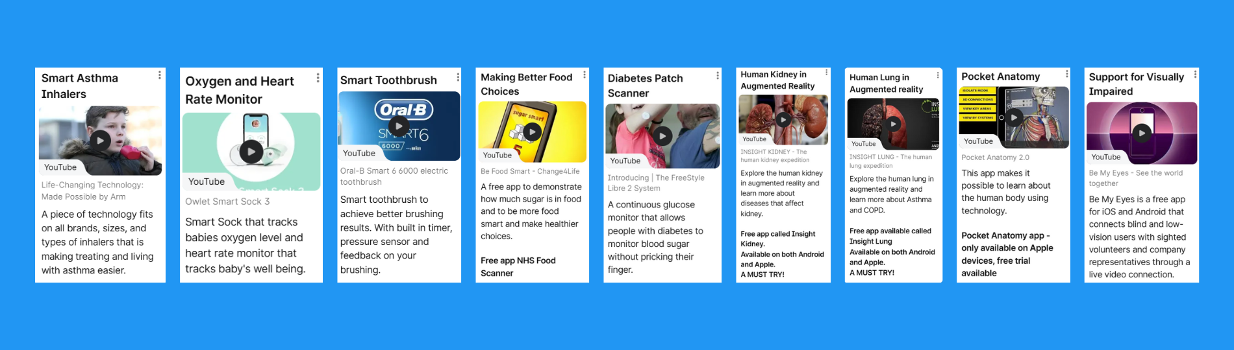
Other digital health and care solutions
Explore some of the digital health technology solutions that exist and are helping people all over the world.
Go to: bit.ly/DigitalHealthTechExamples
Notes:
ACTIVITY TYPE: Practical task pairs/small groups, demo and discussion
NOTE - If pupils are not allowed to use their phones to download and try some of the free apps. Remove the second bullet point on this slide.
TASK - DIGITAL HEALTH TECH SOLUTIONS
- All pupils should explore some examples of digital health tech solutions that exist already.
- Go to bit.ly/DigitalHealthTechExamples
- If pupils have their device, access to free school Wi-Fi and are allowed you could allow them a chance to download some of the free apps. Highly recommended insight lung and insight kidney! Both free apps and available on both Android and Apple.
DEMO PROMPTS
- Open bit.ly/DigitalHealthTechExamples
- There are lots of amazing digital health technology solutions that already exist and are helping people all over the world from a range of different health problems.
- Here are some amazing examples from diabetes patches that track glucose levels and no longer need prick their finger, to smart toothbrushes for better oral hygiene and smart inhalers to help making treating and living with asthma easier.
- You should give insight kidney and insight lung a try!
OPTIONAL TASK
- Allow pupils time to discover other digital health tech solutions.
- If your pupils or yourself find any other ones that you think are great and could help as inspiration please free to email support@dresscode.org.uk with the details and if appropriate we can add to the Padlet this will help the next years entries.
EXTENSION TASK
- Groups can begin to identify what problem they are going to solve.
- Each group should pick what area they would like to focus on; managing own health, fitness and wellbeing (physically, mentally or both).
- Then research what problems they would like to solve, it must be relevant to young people’s health in Scotland.
- Once they have identified a problem they will solve. Each group should begin to research the problem so they understand it more. Gathering facts and figures to show how big the problem is and how it is relevant to young people.
- Groups could share a document, take notes on paper or slides whatever is best for your class or each team.
- All of this will be part of their final pitch.
OBJECTIVES
Continue to raise awareness of how technology is used in real life examples to help solve an issue.

Slide 43
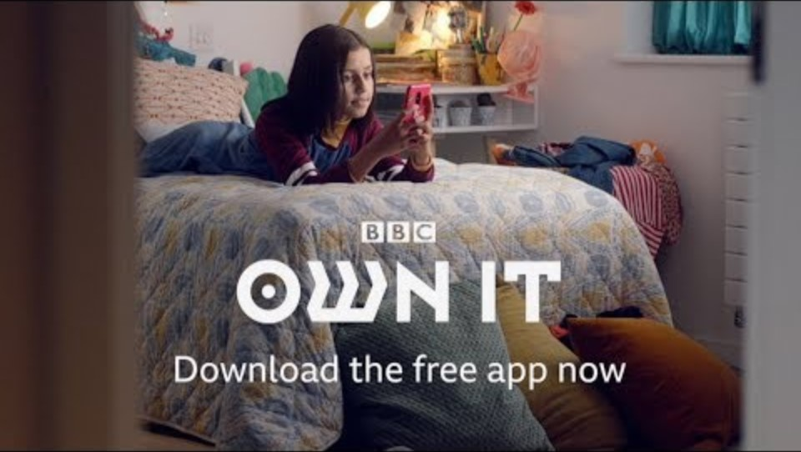
Notes:
ACTIVITY TYPE: Video and discussion
Video length: 36 seconds
Link to video - http://www.youtube.com/watch?v=0w4HMT7PyQ0
NOTE - The BBC Own It app, unfortunately the app is no longer being supported but it gives an example of how technology could be used to help a issue.
PROMPTS
- Technology is embedded in so many parts of our lives and is making a real difference to people's lives.
- Here is an example of the BBC Own It app where technology has been used to address the issue of cyber bullying.
- This is a great app that used technology to help an area of young people's wellbeing. “When the child uses the keyboard, the information they type is analysed by the machine learning in real time and the Own It app uses it to build up a picture of your child’s activity.”
AFTER VIDEO PROMPTS
- Can you think of any other products or apps that use technology to help with a health issue?
- If pupils struggle to give examples. You could mention about a fit bit or a smart watch and ask if anyone can explain it does and how it helps people with their fitness and health.
OBJECTIVES
To raise awareness of how technology is being used already to solve health problems.

Slide 44
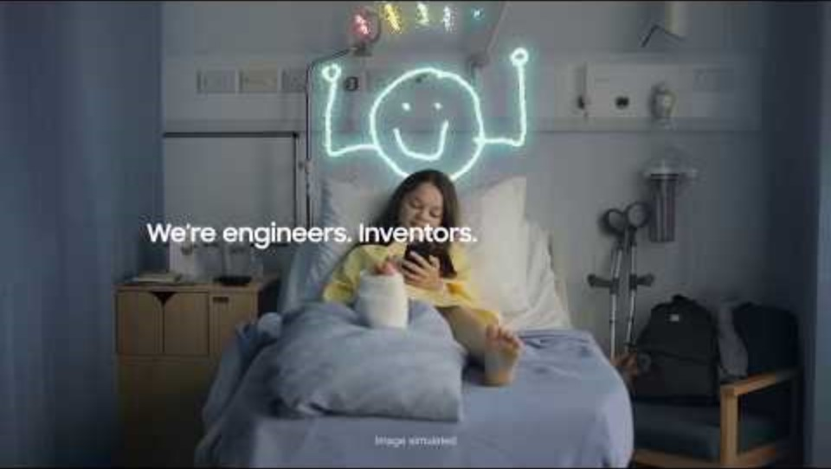
Notes:
ACTIVITY TYPE: Video and discussion
Video length: 1 minute 28 seconds
Link to video - http://www.youtube.com/watch?v=dUhM-zRmrIs
PROMPTS
Your solution should use digital technology and/ or e-gaming.
Remember that the challenge is about designing a unique tech solution.
- Judges are looking for something that hasn’t been done before.
- Although, this isn’t about digital health technology. Here is a short video to help give you some inspiration to think differently.
OBJECTIVES
- To inspire pupils to think differently that their solutions do not have to just be an app or a website.

Slide 45
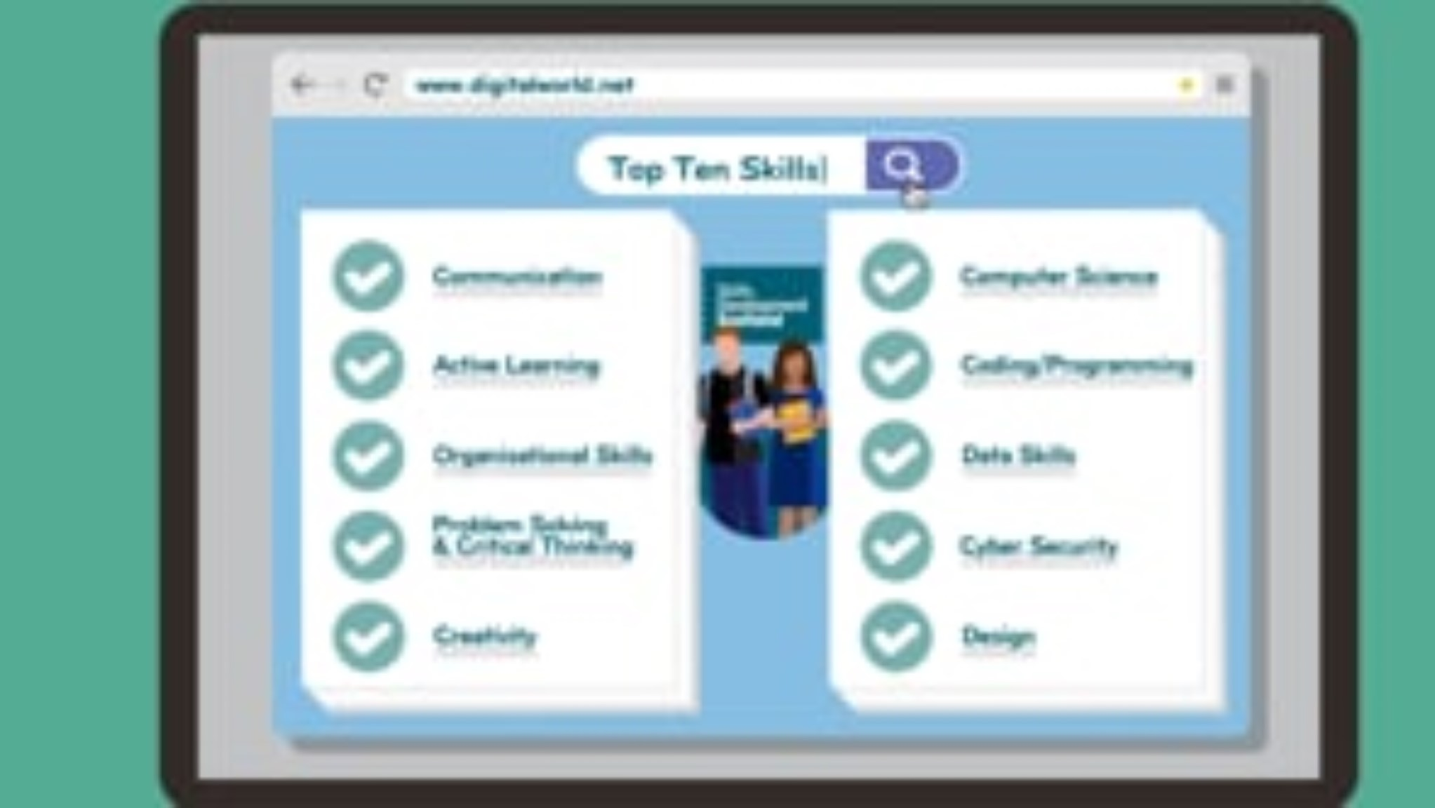
Notes:
ACTIVITY TYPE: Video and discussion – Potential careers in digital health and care solutions
Video length: 1 minute 42 seconds
Link to video - https://vimeo.com/472123347 (paste this into browser)
PROMPTS
- Remember that designing and creating digital health and care solutions can be your job!
- Working in the tech sector means that you can come up with real-life solutions that can make a difference and change people’s lives and help people for the better.
OBJECTIVES
Awareness of the digital health and care sector and that designing and creating digital health and care solutions can be a real career and lots of opportunities in Scotland.

Slide 46

Further learning opportunities
(Scotland only)
On the next slides you will find information for further learning opportunities.

Slide 47
Further learning opportunities, funding and pathways - (Scotland only)
Education Scotland’s STEM nation award - use your work to support your evidence towards an education scotland STEM nation award https://blogs.Glowscotland.Org.Uk/glowblogs/stemnation/stem-nation-award/
Young Enterprise Scotland runs enterprise activities which complement the #digiinventors challenge: circular economy challenge, company programme, team programme (for ASN)
Royal society partnership grants - £3000 available to support your link with a partner organisation for your STEM activities - https://royalsociety.Org/grants/partnership-grants/
Skills Development Scotland - my world of work - https://www.Myworldofwork.Co.Uk/
NHS job website - www.Careers.Nhs.Scot

Slide 48
Good Luck!
Notes:
Apply | Digital Health & Care Innovation Centre

